Slide 1
Responsive browser-based video recording and playback
Oliver Friedmann
CTO & Founder, Ziggeo
@oliverfriedmann

Slide 2
Why not just the <video></video> tag?

Slide 3
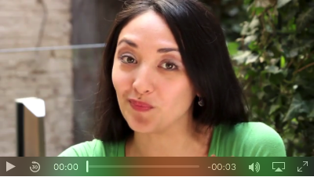
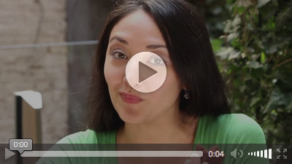
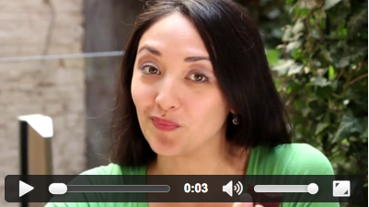
No control over controls.
Safari
Firefox
Chrome / Opera

Slide 4
Video events is a cross-browser mess.

Slide 5








Even new browsers can only play MP4s.
Desktop Web
Mobile Web
MP4 | 3-52 | 21-47 | 3.1-9 | 3-37 | 12-14 | 9-11 | 5.1-9.3 | 4.3-6.0
WEBM | 6-52 | 4-47 | No | 10.6-37 | No | No | No | 4.3-6.0
OGV | 3-52 | 3.5-47 | No | 10.5-37 | No | No | No | No

Slide 6

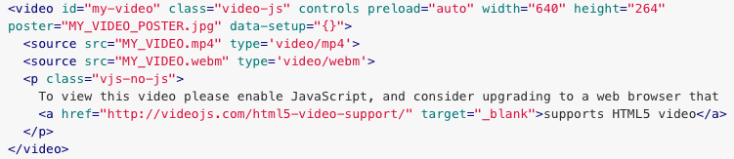
Existing players don’t behave like normal HTML

Slide 7
And if you think playback is broken, here is recording.
Desktop Web
Mobile Web
HTML 5 | Yes | Yes | No | Yes | Yes | No | No | 5.0
MediaRecorder | No | Yes | No | No | No | No | No | no
Flash | Yes | Yes | Yes | Yes | Yes | Yes | No | No
Capture | No | No | No | No | No | No | Yes | Yes

Slide 8
Announcing:
BetaJS Player / Recorder

Slide 9

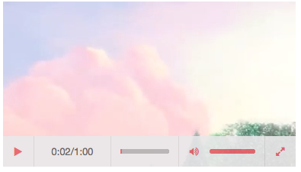
BetaJS Video Player

Slide 10

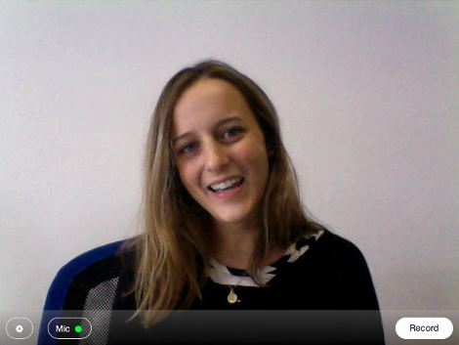
BetaJS Video Recorder
(open source coming soon)
For cloud-based version, visit http://ziggeo.com

Slide 11
BetaJS Player / Recording Browser Compatibility
Desktop Web
Mobile Web
Playback | 15-52 | 4-44 | 5-9 | 18-37 | 12-14 | 8-11 | 7.0-9.0 | 4.0-6.0
Recording | 15-52 | 4-44 | 5-9 | 18-37 | 12-14 | 8-11 | 7.0-9.0 | 4.0-6.0
(Includes falling back to Flash if necessary)

Slide 12
Introducing:
Open-Source BetaJS Framework

Slide 13
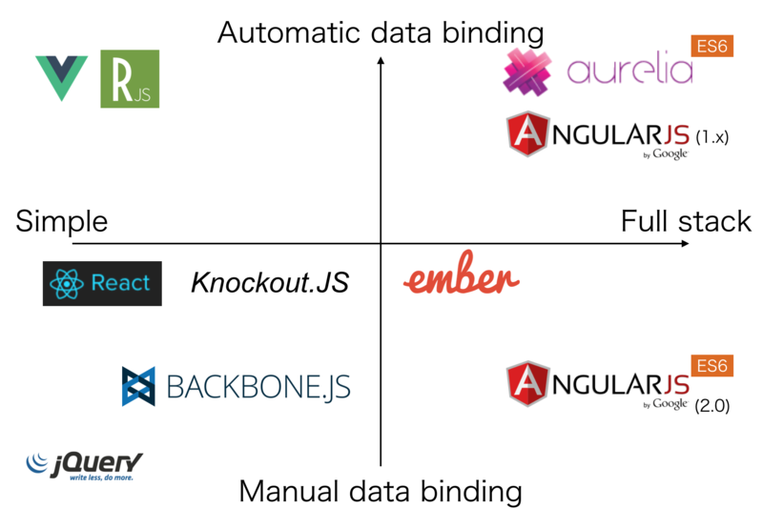

What, yet another framework?

Slide 14
Building Web Components
Extend websites by components like video players
CSS of host website + embeddings don’t play well
JS library dependencies of host + embed don’t play well
because different libraries clash
because different versions of the same library clash

Slide 15
Why iFrames are no good.
Host website cannot properly communicate with embedding
Additional round trips for every embed
Extending embeddings via host website cumbersome

Slide 16
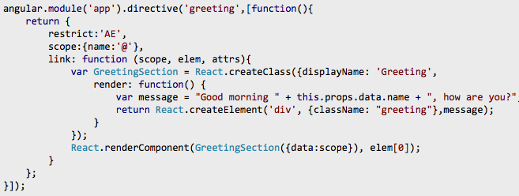
Combining frameworks is not easy.
(Host website must explicitly wrap calls to make it work.)
http://stackoverflow.com/questions/20947191/using-reactjs-with-angularjs

Slide 17
BetaJS Design Principles
No outside dependencies (currently: jQuery but will eliminate in future release)
Play nicely with other frameworks
Loosely coupled and modularized
Allow multiple versions to be present at the same time
Don’t impose page/code structure
Layered customizability
Minimal footprint

Slide 18
Framework Overview
betajs-scoped | scoped loading of modules and dependencies
betajs | helper functions and classes
betajs-browser | browser-specific methods
betajs-dynamics | dynamic DOM templating engine
betajs-flash | Flash-JavaScript bridging framework
betajs-media | a JavaScript media framework (video playback, video recording)
betajs-media-components | full video player / video recorder UI components

Slide 19
Footprint
Module | Size (kb) | Minified (kb)
betajs-scoped | 18 | 9
betajs | 214 | 120
betajs-browser | 64 | 39
betajs-dynamics | 75 | 42
betajs-flash | 11 | 7
betajs-media | 66 | 36
betajs-media-components | 30 | 24
Total | 478 | 277
Compiled for Player | 301 | 172
VideoJS | 697 | 250
JWPlayer | ? | 227

Slide 20
Customization Dimensions
Styles | (Namespaced) CSS
UI | HTML Templating System
Views | JS Controller System (Dynamics)
Themes | Bundling of Styles, UI, Views
Outside Control | Exposed Methods + Events
Locales | String assets for language support
(Customization supports granular changes at each layer)

Slide 21
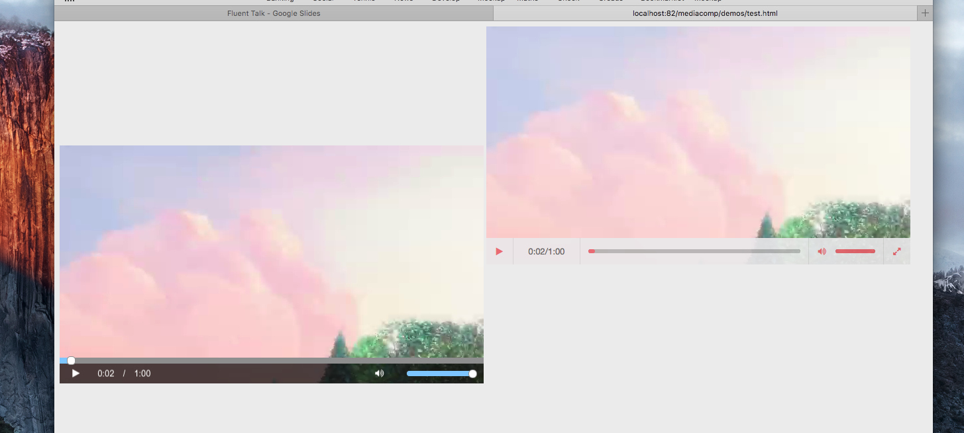
Customizing CSS

Slide 22
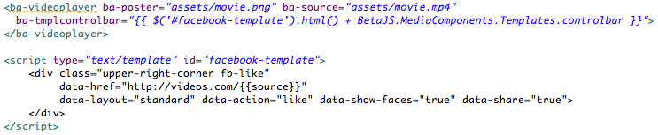
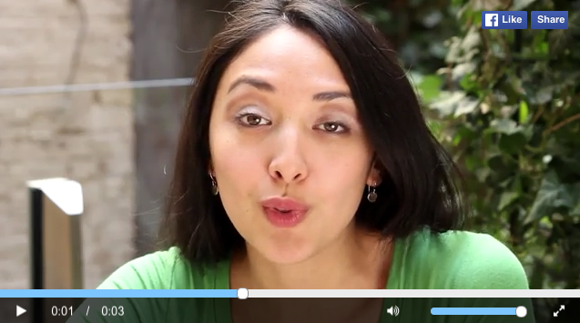
Customizing Templates

Slide 23
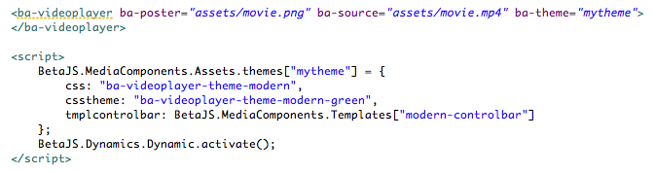
Creating Themes

Slide 24

Adding Locales

Slide 25
Customizing the State Machine
VideoPlayer Class
click play
VideoPlayer.PosterReady
VideoPlayer.LoadVideo
extends
preroll complete
MyPlayer Class
click play
MyPlayer.PosterReady
MyPlayer.Preroll
Notes:
Show Demo

Slide 26

Open-Source Framework
Apache 2.0 License
Commercial Cloud Video & Backend Support

Slide 27
http://betajs.com
Oliver Friedmann
Founder & CTO, Ziggeo
oliver@ziggeo.com

